Slide 1

Working with paginated reports

Slide 2
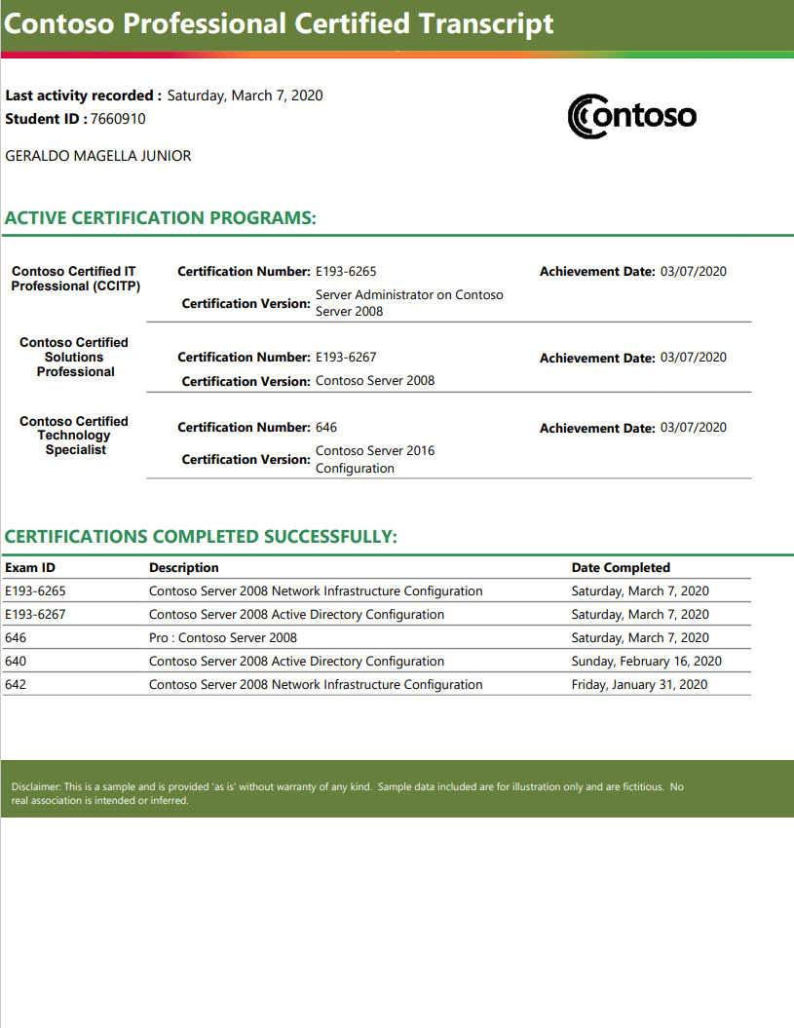
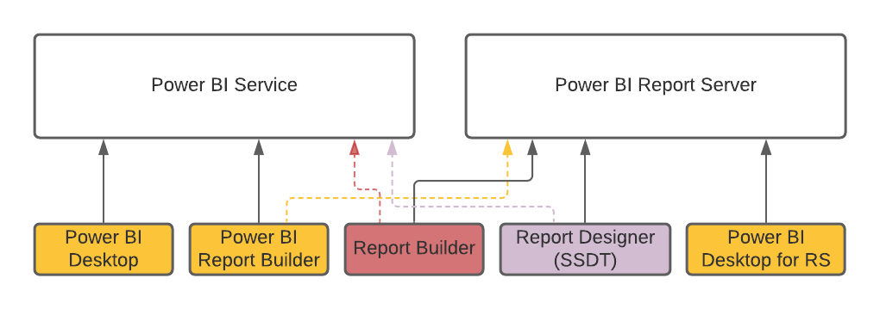
What is paginated report?
Paginated reports are designed to be printed or shared. They're called paginated because they're formatted to fit well on a page. They display all the data in a table, even if the table spans multiple pages. They're also called pixel perfect because you can control their report page layout exactly.
Paginated reports have .rdl extension
Paginated reports can be developed in different tools according to the publishing destination.

Slide 3
Power BI Service paginated reports limitations
Main limitations are:
Interactive features such as document maps and show/hide toggle buttons are currently unavailable
Reports with sub reports are unavailable
No shared data sources and shared datasets available
No custom fonts available, just standard list
Company policies may force you to use Power BI datasets as data source for paginated reports – it causes difficulties when the initial data source is a stored procedure.
Paginated reports for Power BI Service can use Power BI datasets as a data source.

Slide 4
Creating .rdl report with DB connection

Slide 5
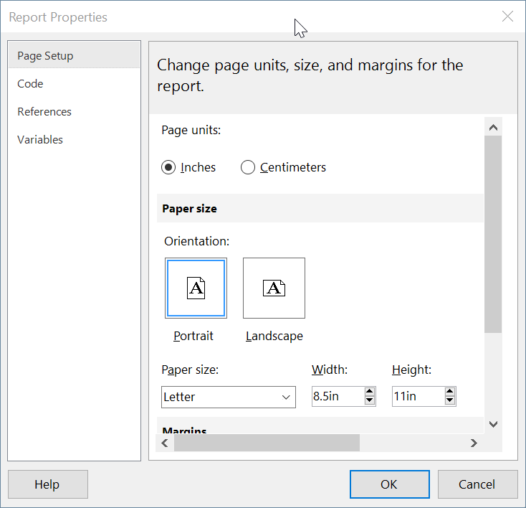
Report properties
Report properties allow us to set up page layout, write some custom VB functions, add .dlls and variables for reference.

Slide 6
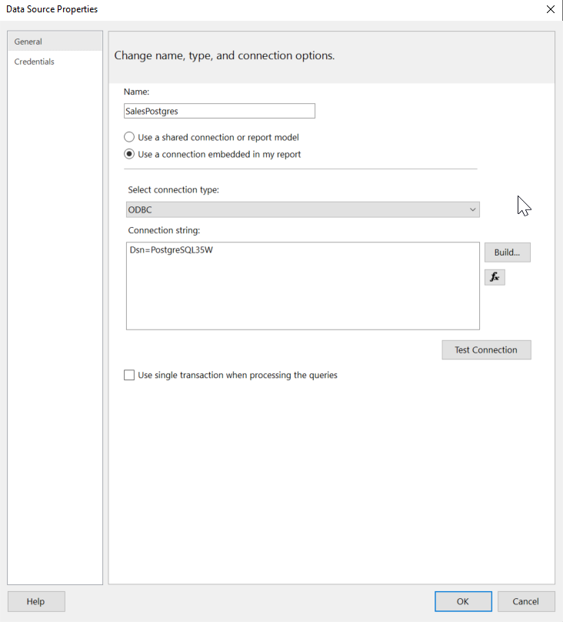
Step 1. Creating Data Sources
There are 2 types of data sources:
Shared Data Source - If you want to share the same data source for multiple reports then you must create a shared data source.
Embedded Data Source – data source for current report.

Slide 7
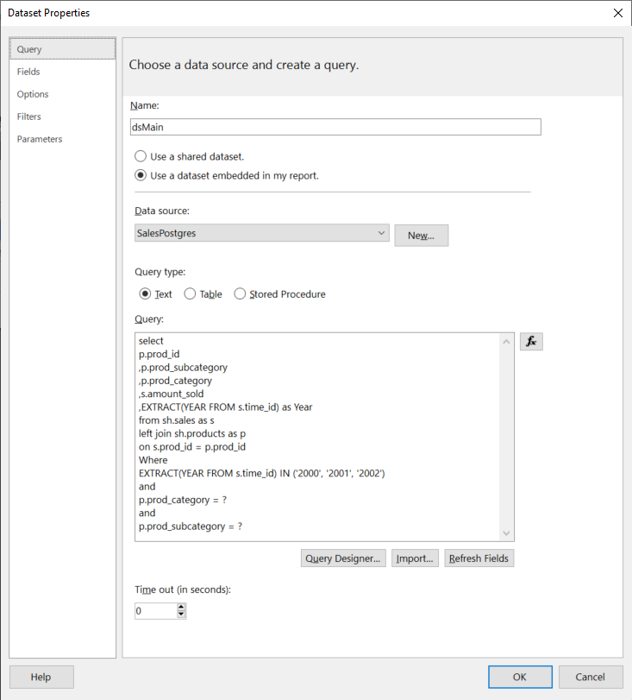
Step 2. Creating Datasets
There are 2 types of datasets:
Shared Data Source - If you want to share the same dataset for multiple reports then you must create a shared dataset.
Embedded Data Source – dataset for current report.
The convention for datasets includes:
Main dataset (used as a main dataset for a table)
Datasets for parameters (usually one dataset per parameter to get distinct values for dropdown)
Other datasets which can be referenced by lookup function

Slide 8
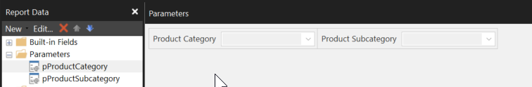
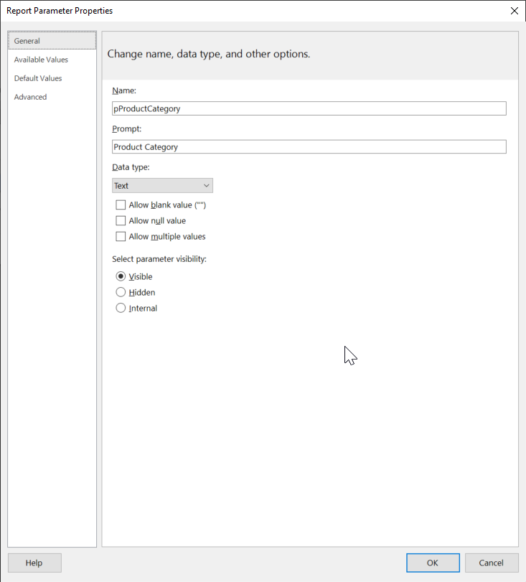
Step 3. Creating Parameters
Parameters are dropdown filters which user interacts with before running the report.
Parameters can be of cascade type i.e., first parameter filters next parameter.

Slide 9
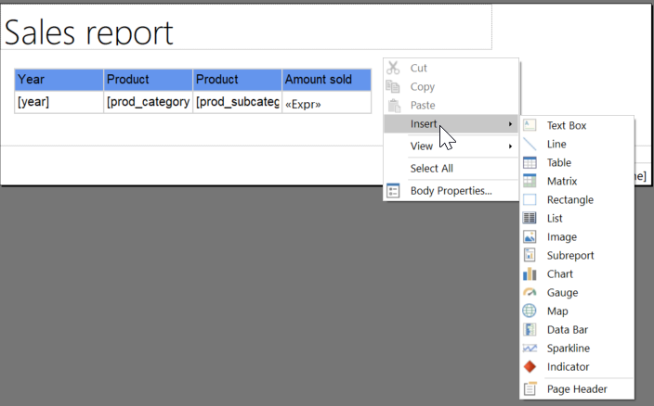
Step 4. Creating visualization
There are different types of visualizations, but table is the most common one.

Slide 10
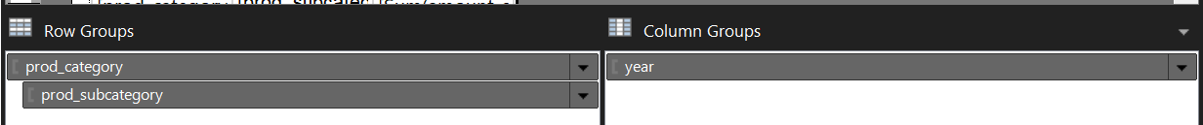
Step 5. Adding groups
2 types of groups:
Row groups
Column groups
Group levels:
Parent group
Child group
Adjacent group
Details

Slide 11
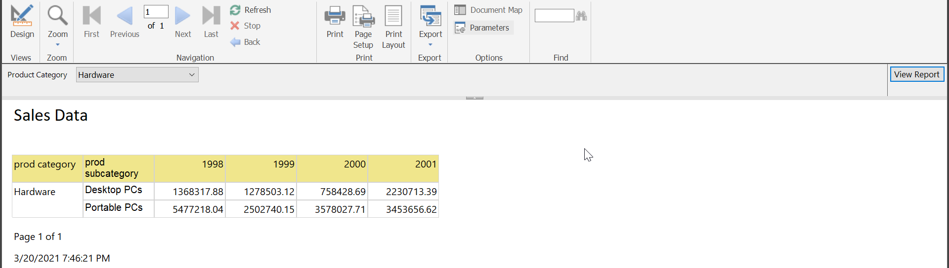
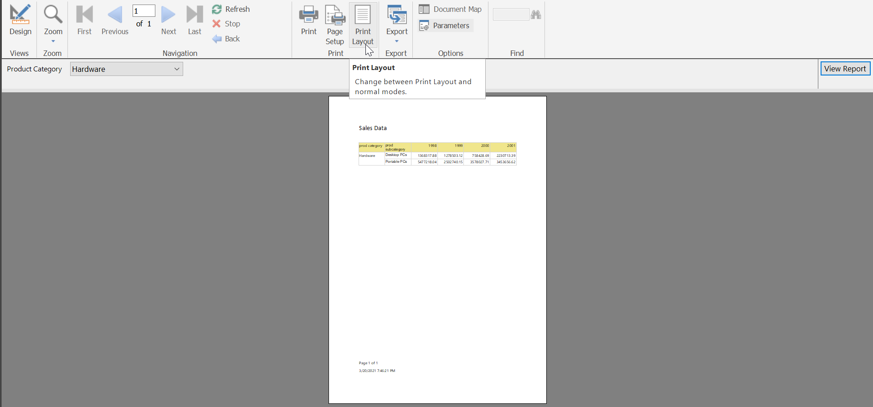
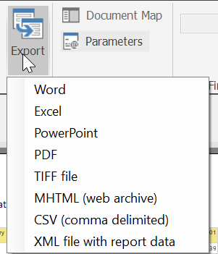
Step 6. Run report

